Slide 1
Local Planning Scheme No. 2
Information Session
February 2022

Slide 2
Purpose
Inform the public, specifically those within the ‘Mixed Business’ area, of the alternate solution (AU13) presented by City Staff to Council following the close of the 2020 advertising period
Provide an opportunity for City staff to answer any questions or concerns in relation to the proposal
Establish whether the proposed alternate solution (AU13) satisfies the concerns raised in the public submissions
Local Planning Scheme No. 2

Slide 3
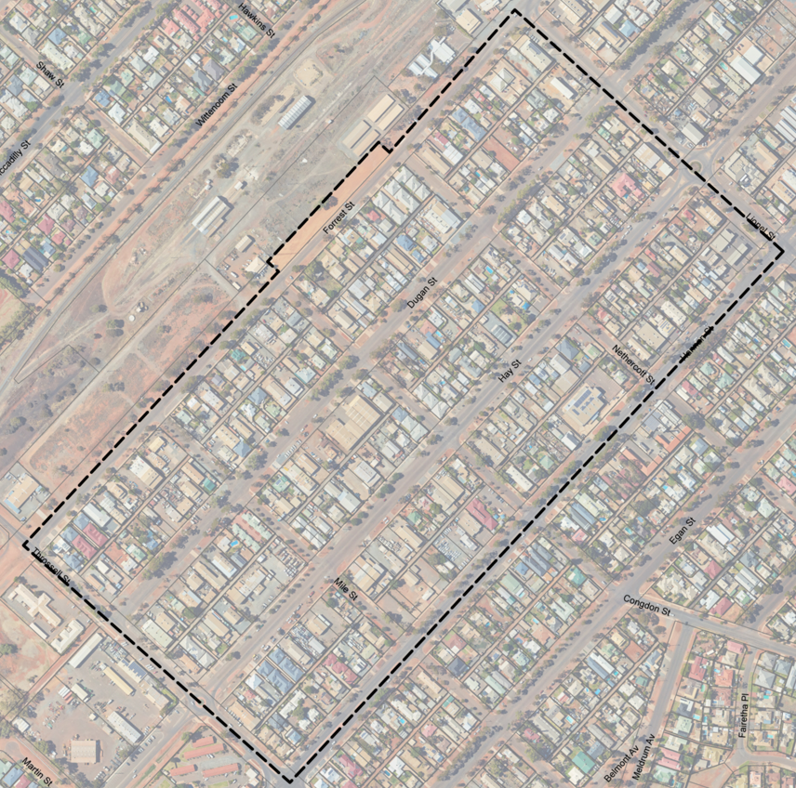
‘Mixed Business’ zone
Thirty Five (35) of the submissions received during the 2020 advertising period relate specifically to land
bound by Throssell-Forrest-Lionel-Hay Streets, commonly referred to as the Mixed Business zone
Local Planning Scheme No. 2

Slide 4
‘Mixed Business’ zone
Local Planning Strategy vs Local Planning Scheme
The Local Planning Strategy recommends that the area be considered for re-zoning to ‘Residential’ with a density of R40 to facilitate the relocation of industrial and light industrial uses from the Mixed Business zone to either the South Boulder or West Kalgoorlie Planning areas.
The advertised Local Planning Scheme No. 2 proposed to rezone the area to ‘Residential’ with a density of R10/50.
Local Planning Scheme No. 2

Slide 6
‘Mixed Business’ Zone Consultation and Response
28 of the 35 submissions received in relation to this area, did not support the advertised rezoning from Mixed Business R30 to Residential R10/50. The submissions highlighted potential adverse commercial impacts in addition to restricting business opportunities if non-conforming use rights take effect.
In direct response to submissions relating to this area, City Staff proposed to modify the advertised Scheme Maps and Text by inserting Additional Use 13 in this area.
7 of the submissions, directly reference/request an Additional Use be established in the area.
Local Planning Scheme No. 2

Slide 7
Additional Uses
Additional use rights provide flexibility to landowners in terms of land use diversity and is suitable in this locality
due to the eclectic mix of land uses that co-exist.
Applies to existing lawful commercial land uses within the defined boundary of Throssell / Forrest / Lionel / Hay streets
Does not apply to existing residential land uses
Applies to LPS2 land use categories considered to be compatible with a residential area
Without modification to the Scheme, additional use rights extinguish when a use lawfully changes to a permitted use within the zone
Supports a natural transition to the residential zone through incentives and increased development opportunity
Properties are listed in Table 5 of the Scheme text
Local Planning Scheme No. 2

Slide 8
Council Resolution
At the 26 July 2021 Ordinary Council Meeting, Council:
Pursuant to Regulation 25 (3) (b) of the Planning and Development (Local Planning Schemes) Regulations 2015, resolves to support Draft Local Planning Scheme No. 2 with proposed modifications to address issues raised in the submissions, as set out in:
Attachment 4 - Scheme Text Modifications
Attachment 5 - Scheme Map Modifications
Determines that Scheme Text Modification 31 and Scheme Map Modification 16 are significant modifications and resolves pursuant to Regulation 26 (1) of the Planning and Development (Local Planning Schemes) Regulations 2015 to advertise the significant modifications for a period of not less than 60 days.
Acknowledge that the 60 day consultation period applies only to the land area defined within Attachment No. 6.
Request an officer report, as soon as is reasonably practicable on the outcome of advertising, for consideration at a Council meeting before the recommendations and information on modified Draft Local Planning Scheme No. 2 are sent to the WAPC pursuant to Regulation 28 (1) of the Planning and Development (Local Planning Schemes) Regulations 2015.
Local Planning Scheme No. 2

Slide 9
Council Resolution
What does it mean?
Most of the Scheme Text and Maps and the modifications made following the advertising period have been supported
The modifications that are deemed to be significant and warrant further advertising relate to the ‘Mixed Business’ zone. Council considered further advertising to be the best way to have confidence that the modified draft scheme adequately addresses the needs of all stakeholders.
The further advertising will only relate to the Mixed Business zone – as noted above, all other aspects have been supported and cannot be revisited through this process.
Local Planning Scheme No. 2

Slide 10
The next step/Questions
Please see us for a submission form

